Slide 1
Java Fundamentals
Author & Presenter –Asfiya Khan (Senior Technical Trainer)

Slide 2
Agenda
Variables in Java
‘static’ keyword
Memory layout
Concept of Garbage Collector
Parameter Passing
Arrays
Enhanced for loop
Packages

Slide 3
Variables
A variable is a name given to memory location. That memory is associated to a data type and can be assigned a value.
int id ;
float rateOfInterest;
char status;
double salary;

Slide 4
Variables
Assigning a value to a variable.
Initialization of a variable with primary value.
1. int accountNumber;
2. accountNumber =2123457788 ; // assignment
3. char choice = ‘A’; // initialization
4. double salary = 56777.24d; // initialization
5. float rateOfInterest = 10.45F;

Slide 5
Types of Variables
Instance Variables : Copy exists per instance
Static Variables : Class level variable i.e. copy exists per class
Local Variables : Variables declared within methods or blocks. They are local to the block where they are declared

Slide 6
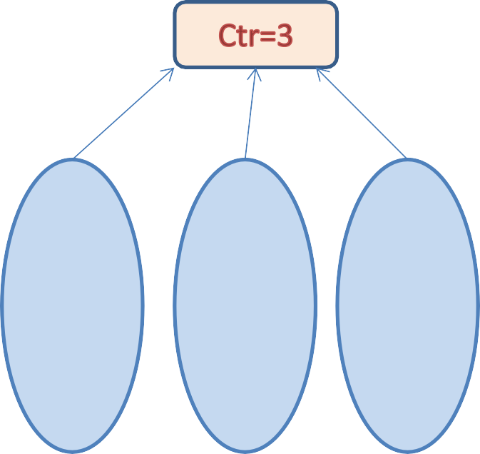
static Keyword
class Date
{
static int ctr; int dd;
int mm; int yy;
}
dd=1 mm=1 yy=1
dd=2 mm=2 yy=2
dd=3 mm=3 yy=3
d1
d2
d3

Slide 7





Memory Layout
Local variables
Dynamically allocated
Area

Slide 8
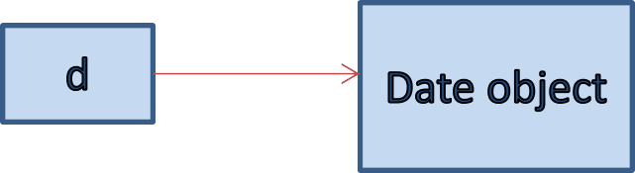
Memory
Local variables are created on stack where as objects are created on heap.
class Demo {
public static void main (String args[]) {
Date d = new Date ();
}
}
stack
heap

Slide 9
Concept of Garbage Collector
Garbage collector generally reclaims orphaned object spaces
Finalize() gets executed just before an object is garbage collected.
Override Object class finalize method to write clean up code.

Slide 10
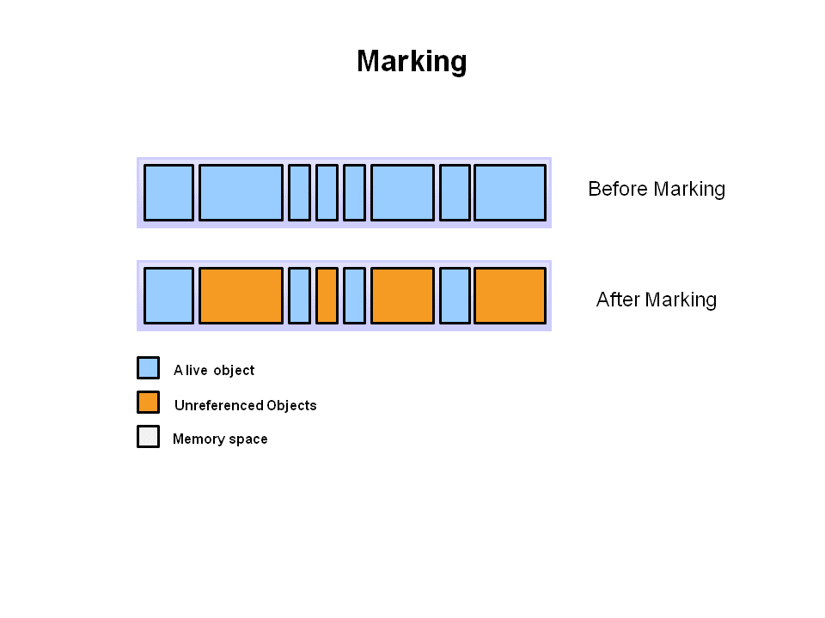
Garbage Collection Phases

Slide 11
Parameter Passing In Java
In Java we can pass parameter to any method by value only.
Whenever we pass any object reference to a method then reference value gets copied inside the formal parameter.
Any modifications to the formal parameter variable inside the called function or method affect only the separate storage location and will not be reflected in the actual parameter in the calling environment

Slide 12
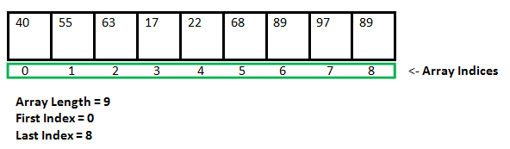
Arrays
An array is a group of like-typed variables that are referred to by a common name.
In Java all arrays are dynamically allocated i.e. allocated on heap.
Since arrays are objects in Java, we can find their length using member length.
Array can contains primitives data types as well as objects of a class depending on the definition of array.
Array elements accessed by
its numerical index.

Slide 13
Array Declaration
type var-name[];
OR
type[] var-name;
An array declaration has two components: the type and the name.
type declares the element type of the array.
the element type for the array determines what type of data the array will hold
name is unique identifier.
int intArray[];
OR
int[] intArray;

Slide 14
Instantiation of Array
When an array is declared, only a reference of array is created.
To actually create or give memory to array, you create an array like this:
The general form of new as it applies to one-dimensional arrays appears as follows:
int intArray[]; //declaring array
intArray = new int[20]; // allocating memory to array
OR
int[] intArray = new int[20]; // combining both statements in one

Slide 15
Array Literal
In a situation, where the size of the array and variables of array are already known, array literals can be used.
int[] intArray = new int[] { 1,2,3,4,5,6,7,8,9,10 }; // Declaring array literal
OR
int[] intArray = { 1,2,3,4,5,6,7,8,9,10 };
The length of this array determines the length of the created array.
There is no need to write the new int[] part in the latest versions of Java

Slide 16
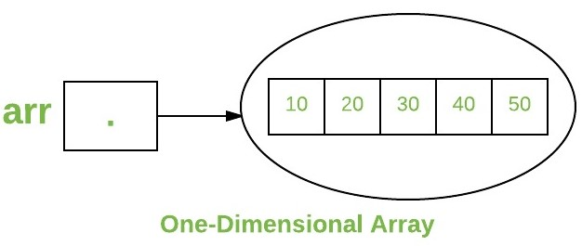
One Dimensional Arrays
int[] arr;
arr = new int[5];
arr[0] = 10;
arr[1] = 20;
arr[2] = 30;
arr[3] = 40;
arr[4] = 50;

Slide 17
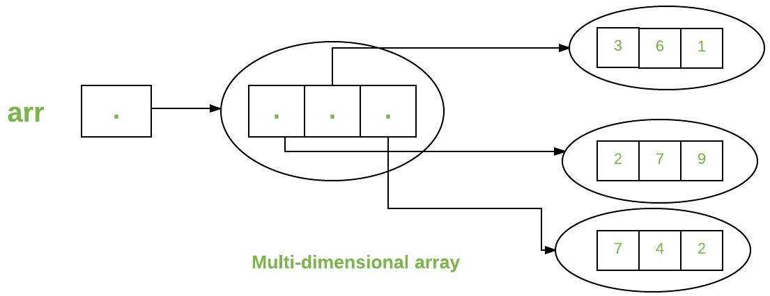
Multi-Dimensional Arrays
int arr[][] = { {2,7,9},{3,6,1},{7,4,2} };
int arr[][] = new int[3][3];

Slide 18
Creating Reference Arrays
Example:
public class MClass{
public MClass(int x , int y){
System.out.println("constr" + x + y );
}
public static void main(String [] a){
MClass[] p;
p = new MClass[10];
for ( int i=0; i<10; i++ ) {
p[i] = new MClass(i, i+1);
}
}
}

Slide 19
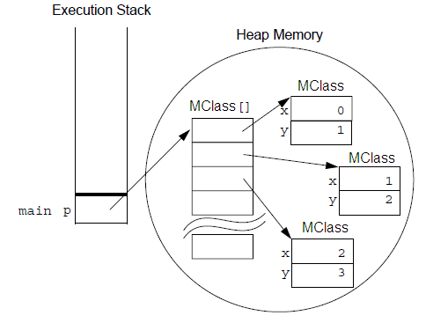
Creating Reference Arrays (Contid)

Slide 20
Array Bounds
All array index begin at 0:
public void disp() {
Int [] x = new int[5];
for (int i = 0; i < x.length; i++) {
System.out.println(x[i]);
}
}

Slide 21
Packages
A package is a grouping of related classes & interfaces providing
access protection and name space management
Programmers bundle groups of related types into packages to make it easier to find & use related classes & interfaces
Packages help to avoid naming conflicts
There can be only one package declaration per source file
In case if no package is declared, then the class is placed into
the default package i.e., the current folder

Slide 22
Packages Contd.
If you want to create a package ,the package statement should be the first statement.
The fully qualified name of a class is : packageName.className
Fully qualified name of class Date in java is
java.util.Date
package subpackage class name
name name

Slide 23
Packages Contd.
package p1; import java.util.Date; import java.sql.*; class MyClass { }
Basic Structure Of Java File
Package statement……optional
Import statements …..optional
Standard class writing

Slide 24


Slide 25


Thank You!
9/4/2019
www.cybage.com
Copyright © 2019 Cybage Software Pvt. Ltd. All Rights Reserved. Cybage Confidential.

